Slide 1
PowerPoint presentation
Unit 308: Career awareness in building services engineering
Building services engineering careers

Slide 2
Careers
While the role increasingly demands a multidisciplinary approach, some building services engineers choose to specialise in a certain area, such as:
installation electrician
heating and ventilation service and maintenance engineer
plumber
heating and ventilation engineer
refrigeration engineer
maintenance electrician
ductwork installer
air conditioning engineer.

Slide 3
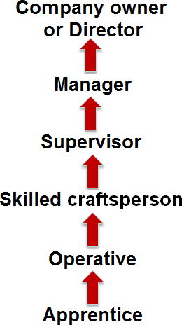
Careers
There are opportunities for progression in all these areas:

Slide 4
Opportunities
When you have worked for a company for some time, and have gained experience and qualifications, there are always opportunities for sideways moves – either within the company or with another company. Here are some examples:
Different craft area (eg general electrical installation to installing renewable microgeneration technologies – PV, wind etc).
Installation to maintenance.
Maintenance to sales.
Domestic to commercial.

Slide 5
Types of work
Contract work
Private work
Consultancy:
lighting design
security alarm systems
electric space heating
lightning protection
renewables
Subcontractor
Casual labour

Slide 6
Any questions?

